Slide 1
Restaurant Order Management System

Slide 2
Agenda
Introduction
EER Diagram
Class Diagram
Implement
Conclusion

Slide 3
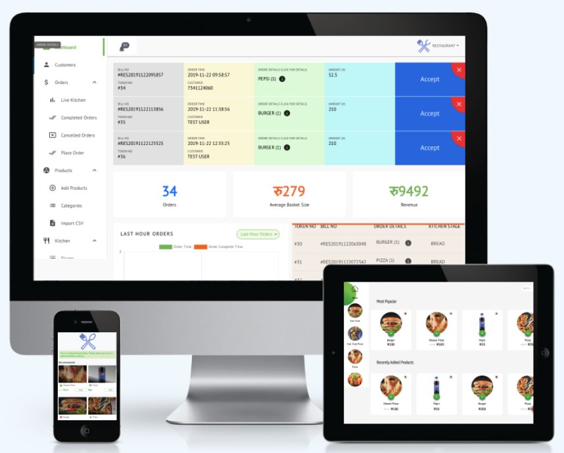
Introduce
The Business can:
Manage menu: add, delete, modify, query
Manage user
View pending orders
View all orders
The Customer can:
Edit own information
Order the menu
Track order: order status, order detail and history order information
Register
Order
Process
Checkout
comment

Slide 4
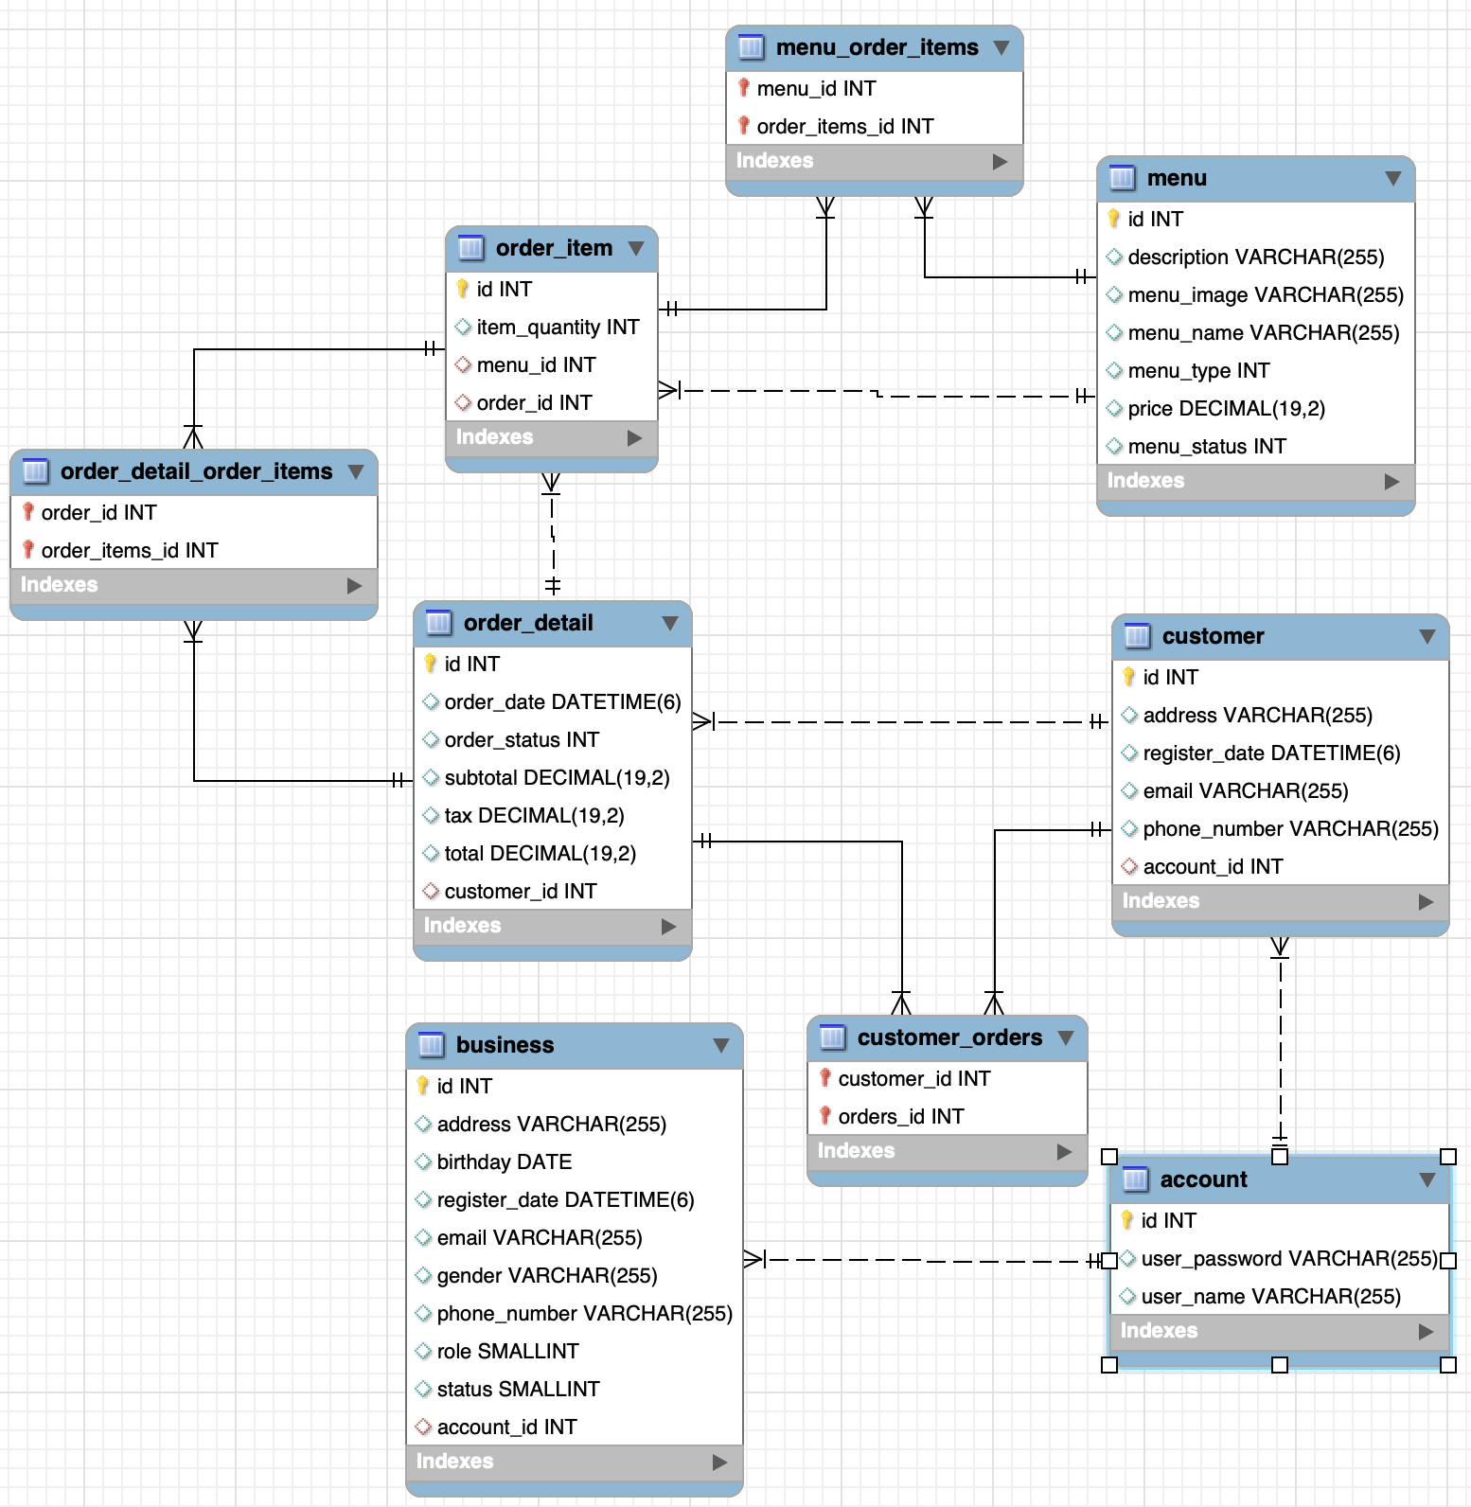
EER Diagram

Slide 5
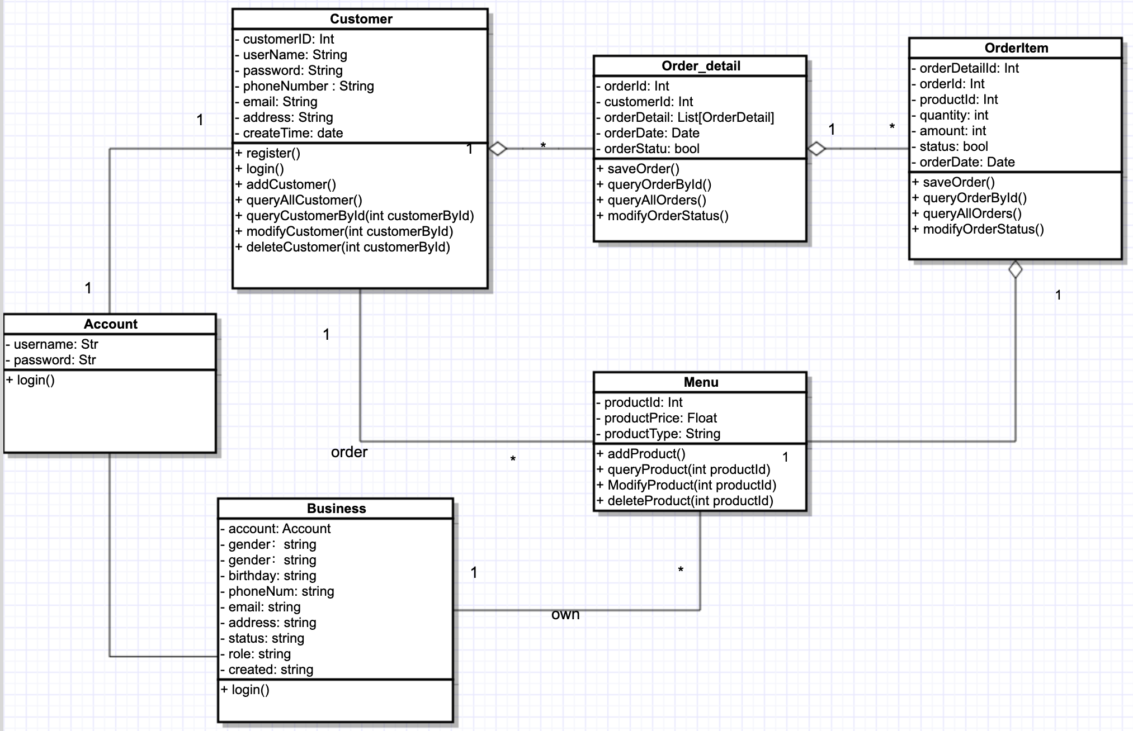
Class diagram Explanation

Slide 6
Implement
Front-end: Html CSS Ajax Bootstrap5
Back-end: Springboot JPA
Database: Mysql

Slide 7
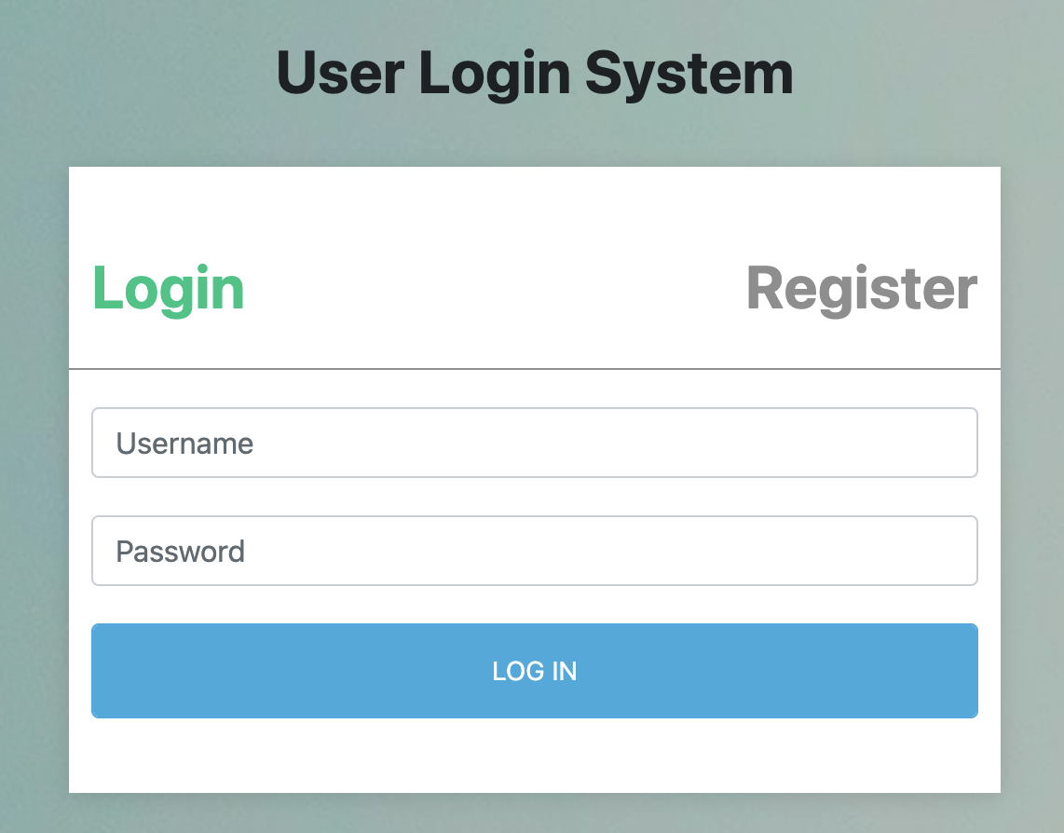
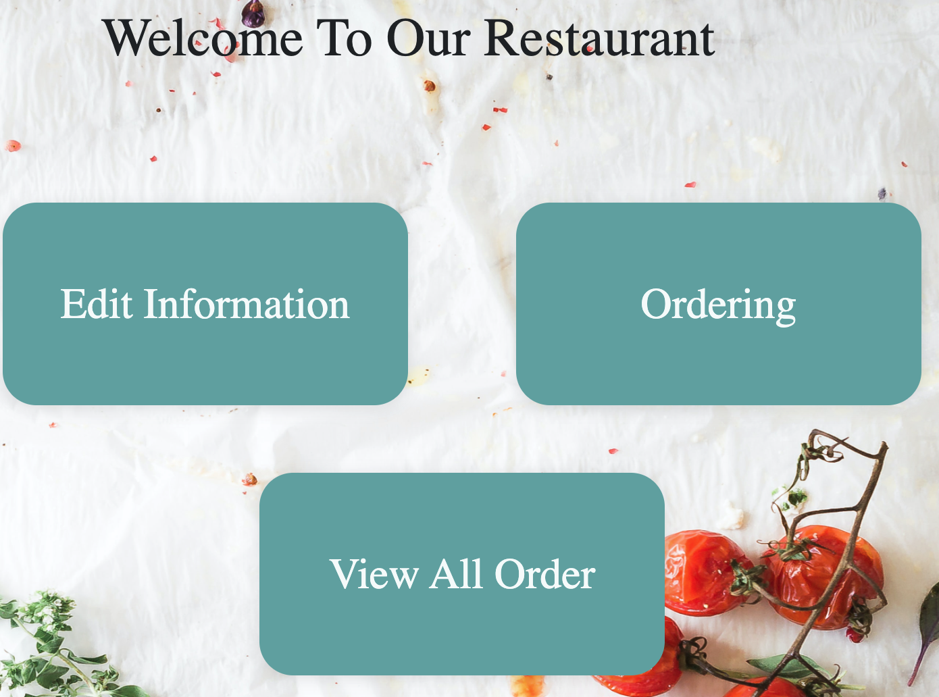
Customer Client
Login
Register
Edit Customer Information
Place Order
View all Orders

Slide 8
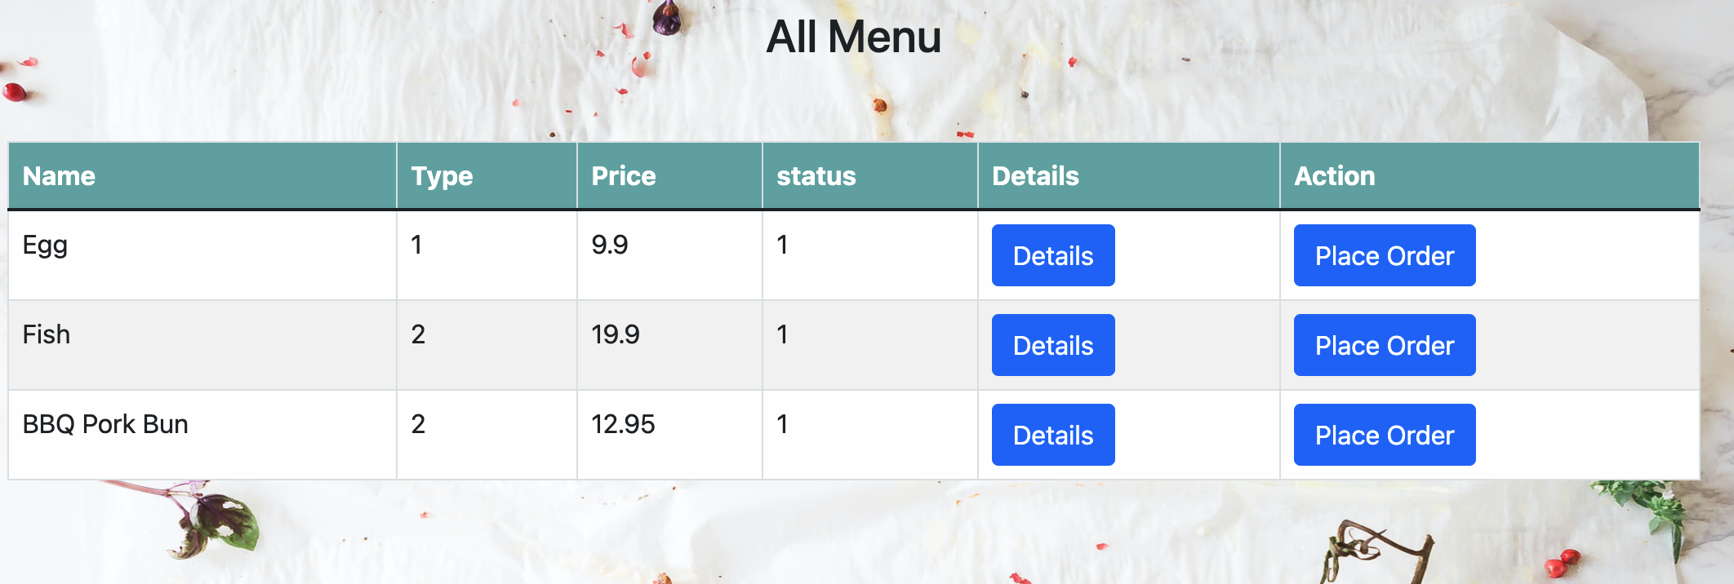
Place Order

Slide 9
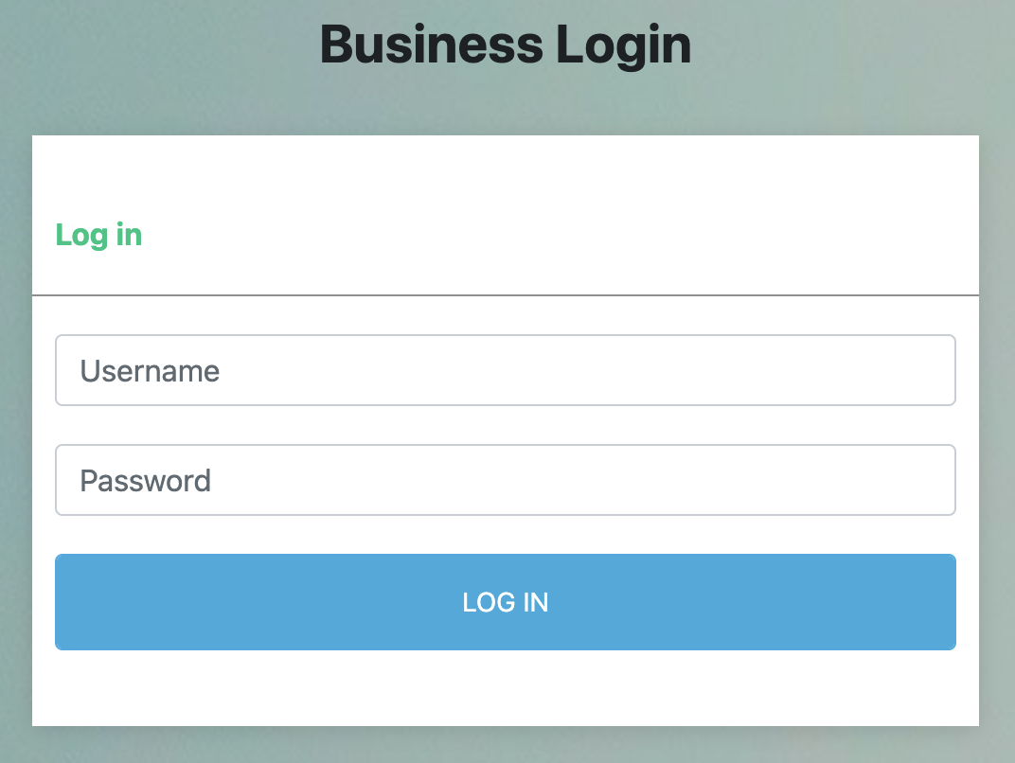
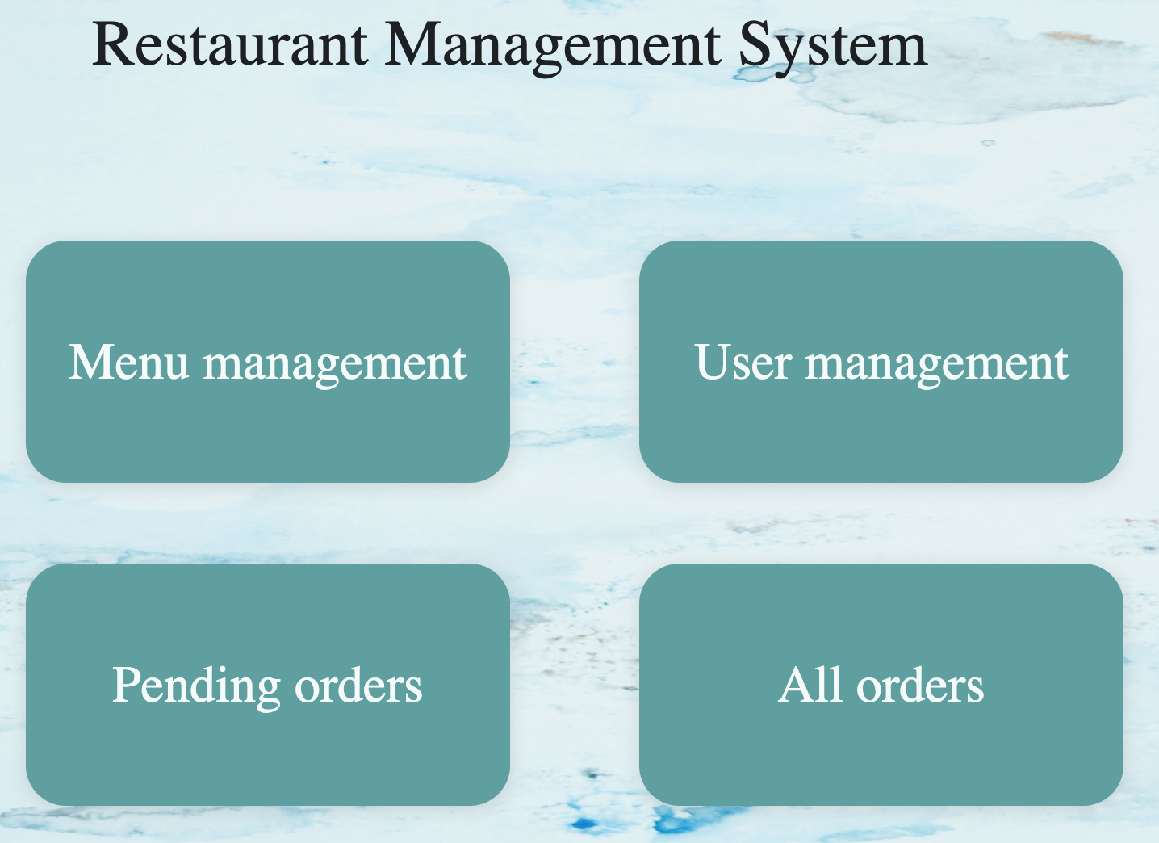
Business Client
Login
Menu Management
Add menu
Edit menu
delete menu
Customer Management
Add customer
delete customer
Order Management
Pending orders
All orders

Slide 10
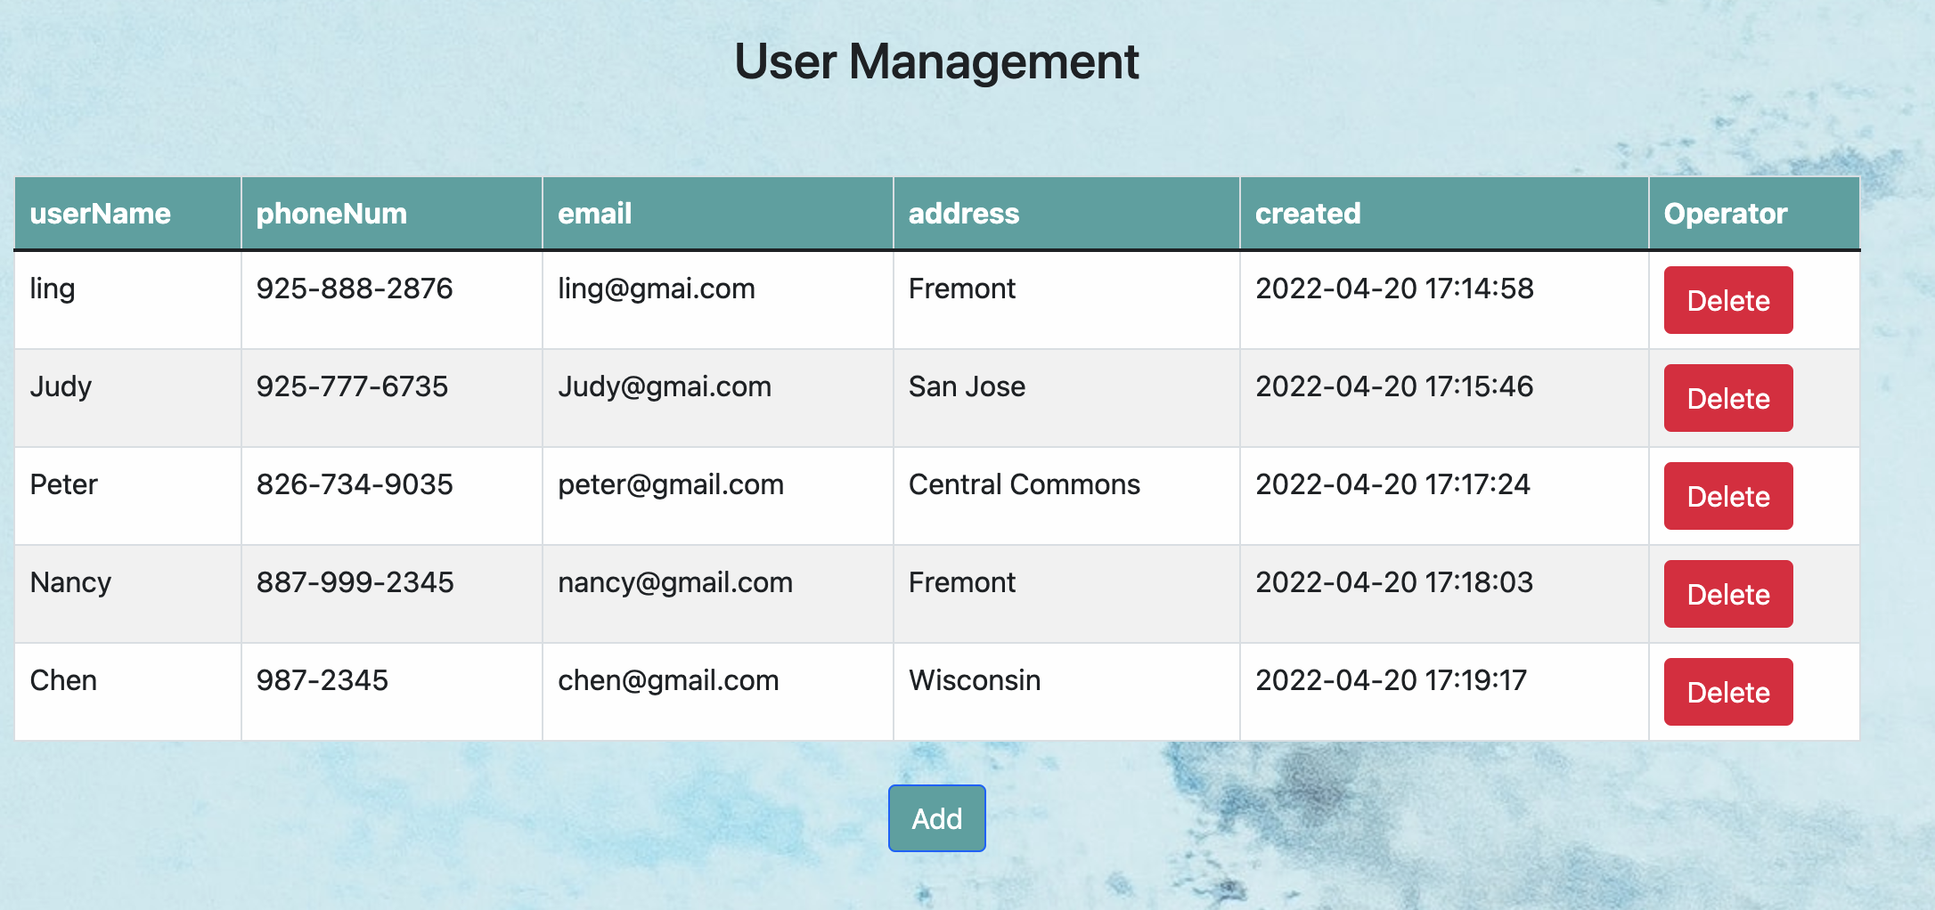
User Management

Slide 11
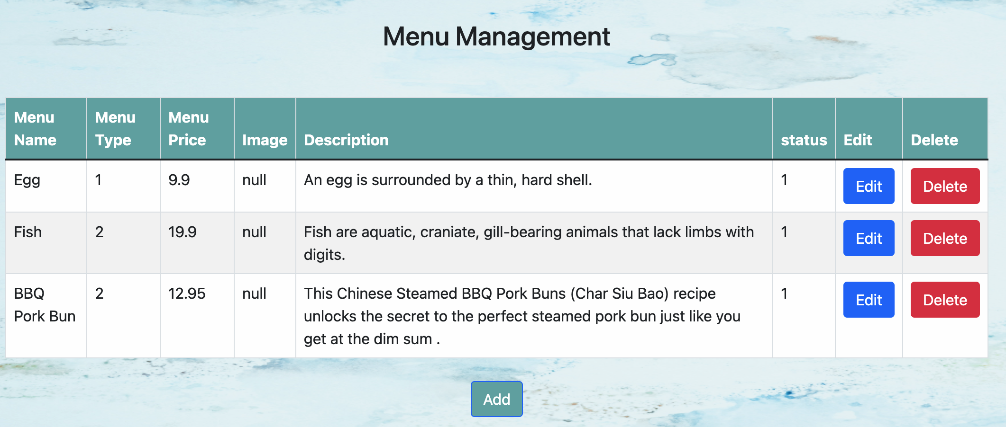
Menu Management

Slide 12
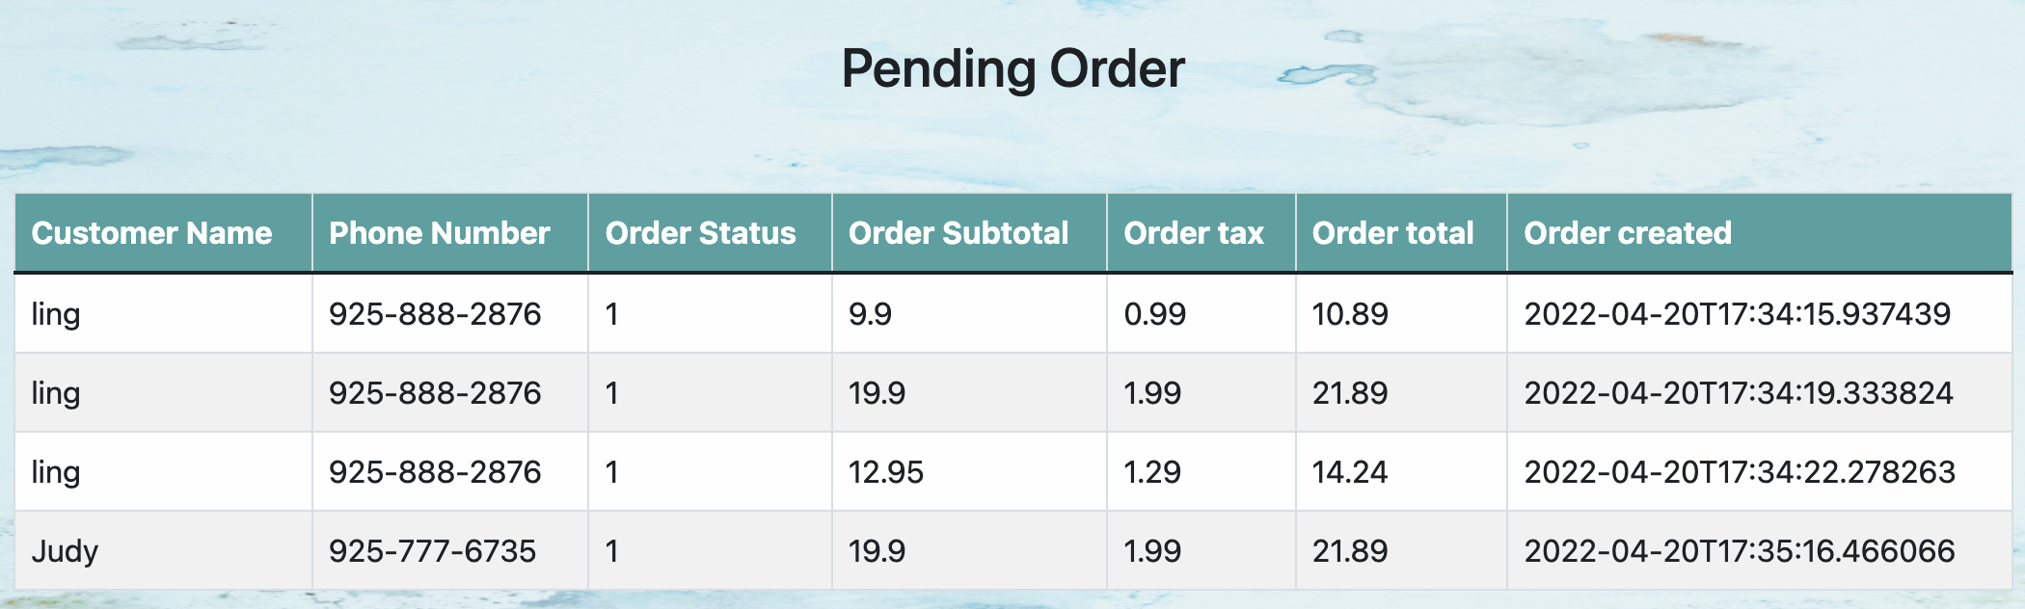
Pending Order

Slide 13
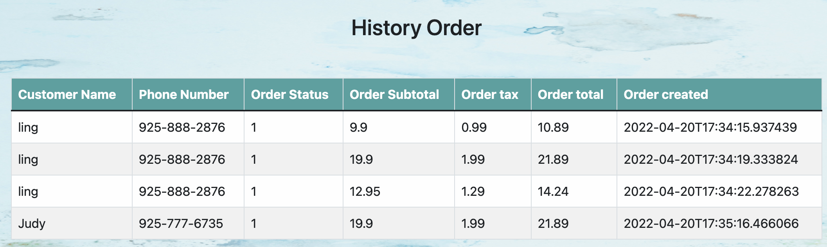
History Order

Slide 14

Conclusion
Order management system provide business a digital way to manage restaurant.
ER diagrams analyze existing databases to find and resolve problems in logic or deployment.

Slide 15
Thank you!

